Slide 1

How Security Products Could Change The World
…and Often Don’t
Bob Stratton
=
=
Notes:
Introduce yourself
Thank them for the opportunity to speak with them
What I hope to convey to them over the next 15 minutes is:
An understanding of how security product companies are different from service companies
What you stand to gain from starting a product company
What it takes to be “investable.”
A little bit about our program

Slide 2

Who is this guy?
TCP/IP zealot & commercial s/w developer
Serial security entrepreneur
Pentester
Researcher
Investor
InterCon (ALU), UUNET (VZ), WheelGroup (Cisco), SDI (Cylink), IQT, Symantec…

Slide 3
The Gist
The Good and Bad of Products
How Value Is Delivered
Why Even Great Innovations Face Resistance
Who Are the Gatekeepers?
Why Products are Different (from Services)
What Exactly Gets “Disrupted?”
Who Can Pull This Off?
When Is a Problem Not a Problem? Why Is That a Problem?
Where to Find People Who Share the Vision
Balancing Focus with Listening to Your Universe
The Market You Choose Guides Your Funding Needs
Possible End States

Slide 4
Why Security Products Matter
Threats and Defenders are Asymmetric
Services are great (and often fun) but…
We don’t scale
We can only bill so many hours in a year
Products can capture rare expertise
Making it more available to the world
They can change the world

Slide 5
Products Aren’t Panaceas
“The Good is the enemy of the Best”
Or the “good enough”
You can only choose certain battles to fight
Human factors matter

Slide 6
There Are Enemies to Innovation
“Creative” competitors
Unenlightened consultants
The industry analyst industry
Your own biases
Notes:
VA tools ask the MDM? Really?
A robot might take your job
You’re making work or causing a fiefdom split
If I can use it anyone can

Slide 7
Names Matter
Industry Analysts:
Report on technology developments
Guide vendors
Help customers select products
Make money from everyone
Keepers of the categories
If people don’t know how to think of a product, they often won’t.

Slide 8
Services/Products
Consulting
Cheap to start, expensive to grow
Quick revenue, but there’s a cap
Disincentives to product innovation
Customers like attention

Slide 9
Services/Products
Product companies
Takes longer to get to revenue
Have to spend $$$$ to build
Have to spend $$$$ to cut through noise
Customers still want attention(Support/QA)
Can find a variety of funding sources

Slide 10
Services/Products
For product companies, it’s all relationships:
Sales channels
Marketing / “mindshare”
OEM / licensing partners
Wide array of possible end states

Slide 11
What Gets Disrupted?
Addresses a problem in a new way
Addresses the same old problem but 10x
Faster
Better
Cheaper
Is easier to use the way real people use things

Slide 12
When is a Problem Not a Problem?
The most important question for any product company is “What problem are you solving?”
The answer will never be
A statement of capabilities
A technology description
A benefit

Slide 13
Why is That a Problem?
Customers don’t walk around thinking about benefits
We don’t dislike sales people, we dislike
bad sales people
Good ones don’t even feel like sales conversations

Slide 14
Who Can Pull This Off?
We are formed by the problems we have & have solved
Remember that “relationships” thing?
It involves talking & listening to people
Wealth / Fame / Control – select one
(but you might get two later)

Slide 15
Sharing the Vision
Find frustrated people – root of innovation
Find People who want to have impact at scale
Find those more into building than talking
Long term vision and no tolerance for ceilings

Slide 16
Focus vs. Adaptation
The universe tells us what products to build
If we ask
Over and over and over
Balance:
A resolute focus on solving the problem
A constant willingness to be wrong and hear it.

Slide 17
The Supporting Players
Investors want to support real innovation
As many kinds of funding as companies
Angel, Inst. Angel, VC, Strategic VC, PE
Product companies make tech media possible
People listen to what you have to say

Slide 18
End States
It’s hard to innovate when you’re huge
Many buy, not build
“Powered by…”
White label
Fame & customer support vs. getting paid
IPO

Slide 19
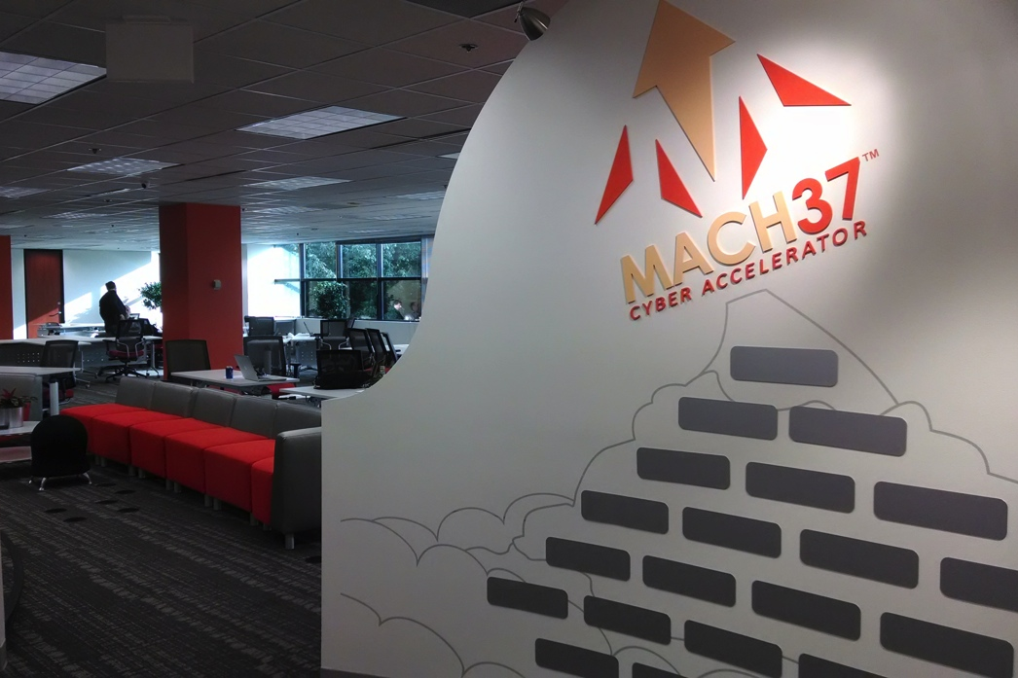
Thanks!
Address: 2214 Rock Hill Rd Suite 270
Website: www.mach37.com
Email: Bob.Stratton@mach37.com
Phone: 703-956-6161
Twitter: @strat

